Slide 1
Analyzing networks
AIMS Day 3

Slide 2
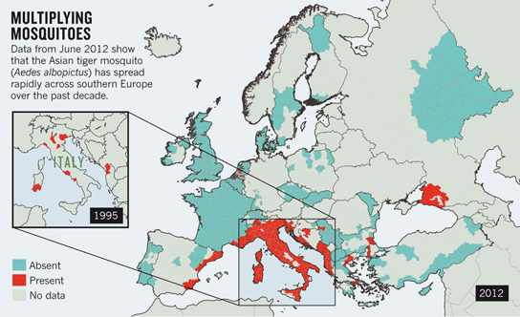

What can you do with these models?
These models useful when your research question are spatial
Some places differ
Account for transmission rates in different areas
Mosquitoes in some areas but not others
Account for emergence and spread
Account for different policies

Slide 3
Learning objectives
Understand what is often observed in spatial models
Network dynamics: What is a “central” node?
Source-sink dynamics

Slide 4
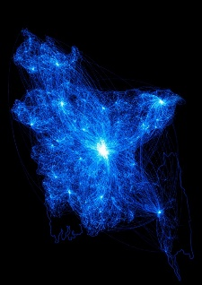
Mobility data
Often, we have fine-grained data
Lots of locations, lots of flows
How can we determine key patterns in this network?
What places are at-risk of spread?
What places are key intervention targets?

Slide 5
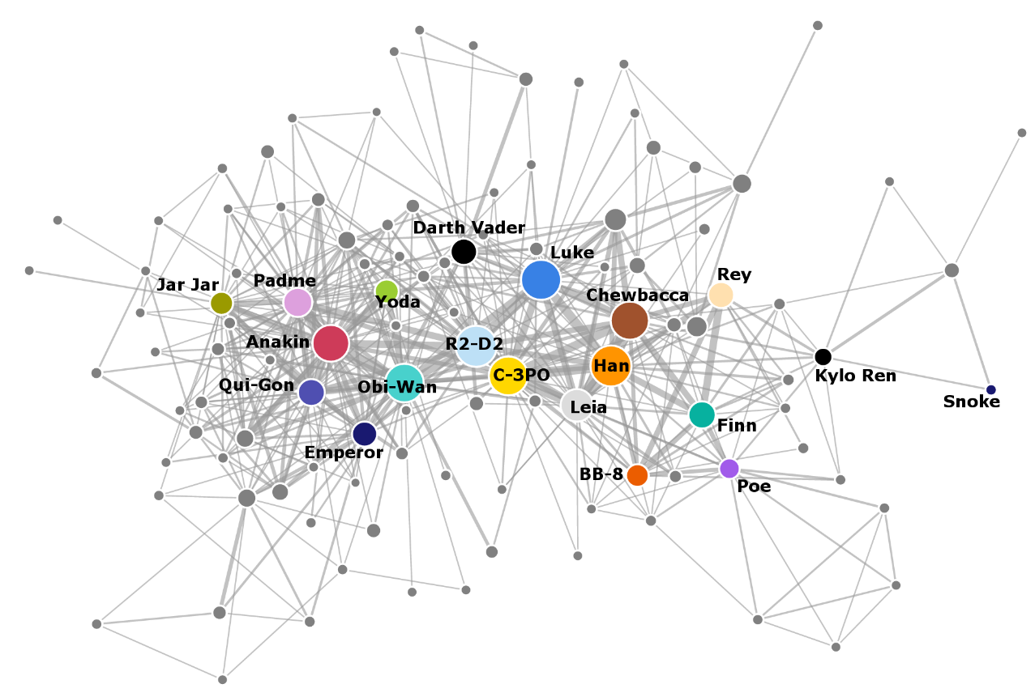
Identifying key targets
Transmission occurs in shared spaces
Who is most likely to share space?
Social network analysis can define who is most connected and most likely to spread disease
Informs surveillance, targeting of interventions
Helps identify potential superspreaders, well-connected people

Slide 6
Social networks
Various ways to define connections between nodes
Nodes can be people, or communities, or places
Ex. Kigali and Kampala are very well connected, major ”nodes”/patches
Connections can be communication, shared time spent, or other interactions

Slide 7
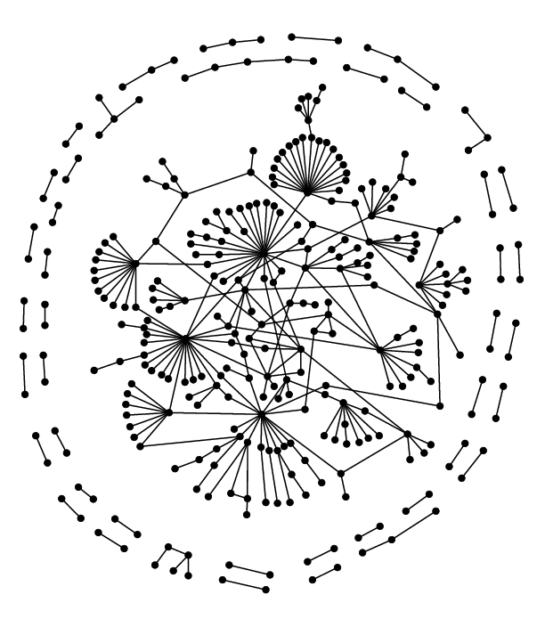
Network of physical interactions between nuclear proteins [...] consisting of all proteins that are known to be localized in the yeast nucleus [...], and which interact with at least one other protein in the nucleus.
This subset consists of 318 interactions between 329 proteins.
Note that most neighbors of highly connected nodes have rather low connectivity.
Maslov and Sneppen 2002
http://arxiv.org/abs/cond-mat/0205380
Protein networks in yeast

Slide 8
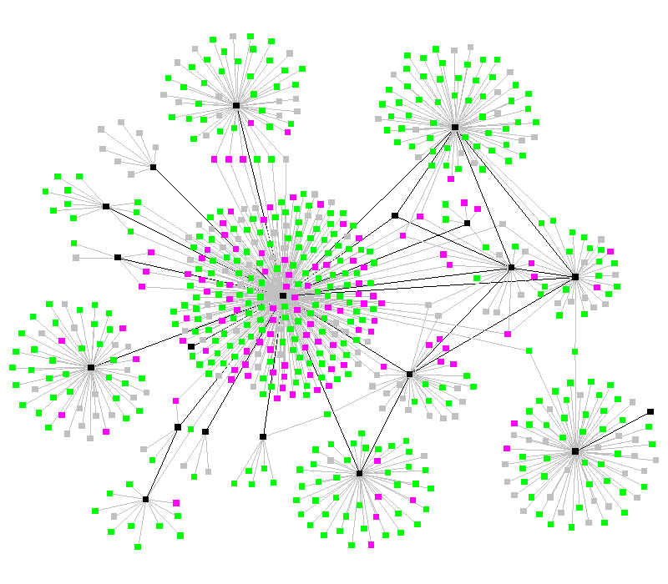
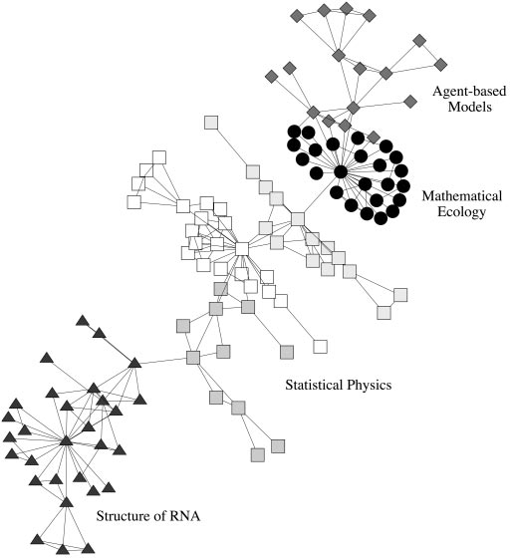
Spread of TB
Scientific collaboration
Black nodes are persons with clinical disease (and are potentially infectious), pink nodes represent exposed persons with incubating (or dormant) infection and are not infectious, green represent exposed persons with no infection and are not infectious. The infection status is unknown for the grey nodes.
Unfortunately the 'social butterfly' in this community, the black node in the center of the graph, is also the most infectious -- a super spreader.
http://www.orgnet.com/contagion.html
The largest component of the Santa Fe Institute collaboration network, with the primary divisions detected by our algorithm indicated by different vertex shapes.
http://www.pnas.org/content/99/12/7821.full.pdf+html

Slide 9
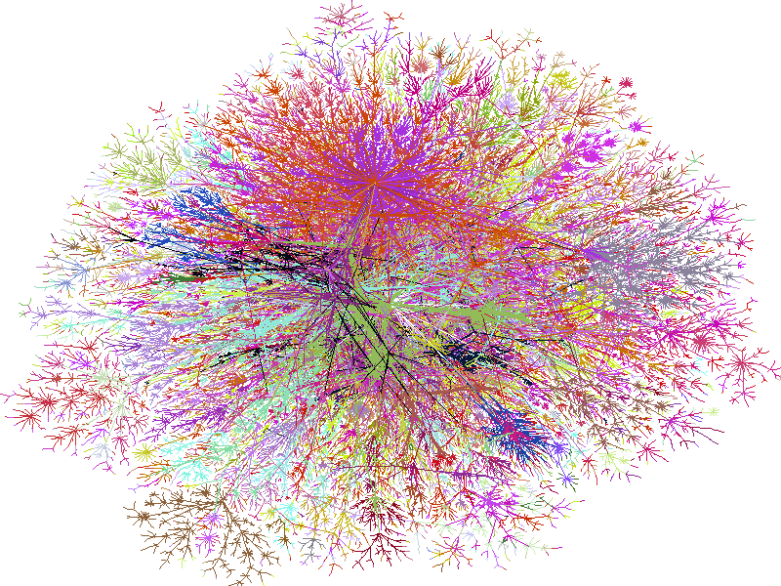
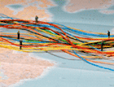
The Internet
http://www.lumeta.com/research/

Slide 10
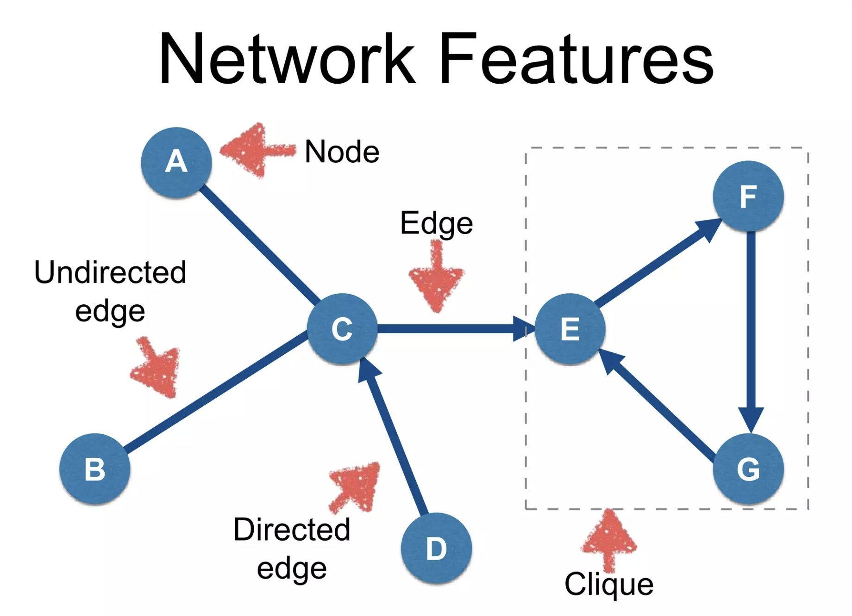

Slide 11
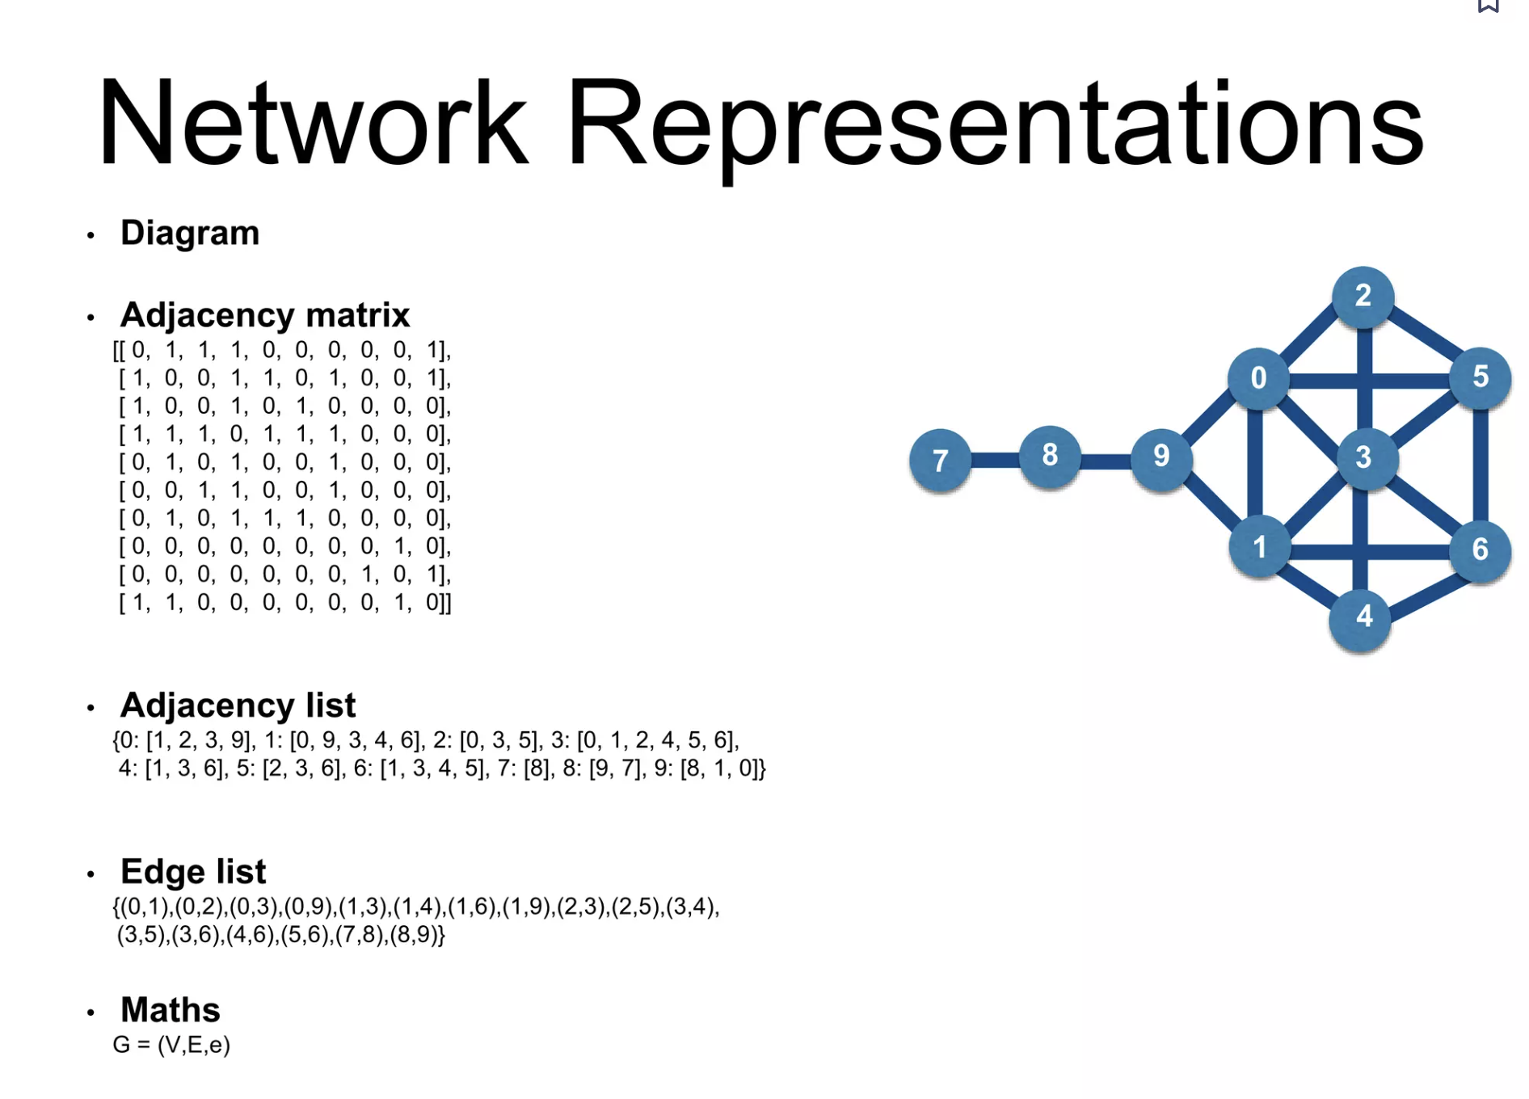

Slide 12
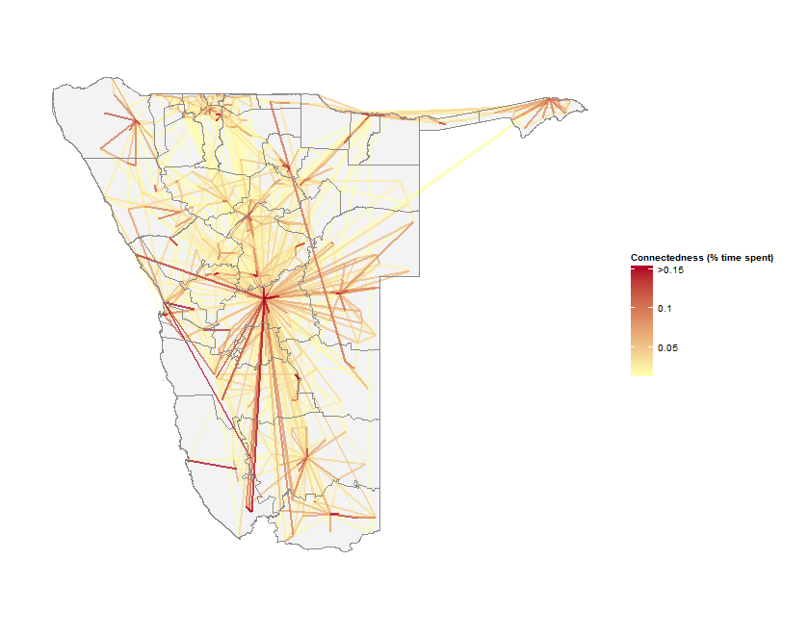
Networks example
We can define the social network of Namibia using mobile phone data
Then, analyse connections between communities
Which are most connected?
How will malaria spread throughout the country?
Community detection

Slide 13
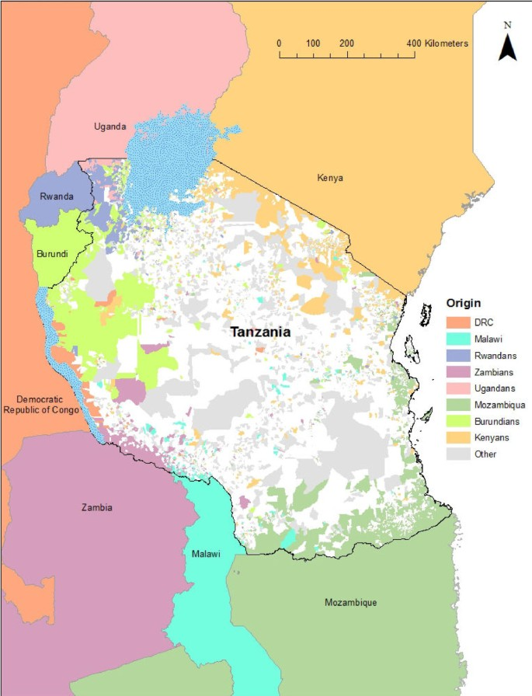
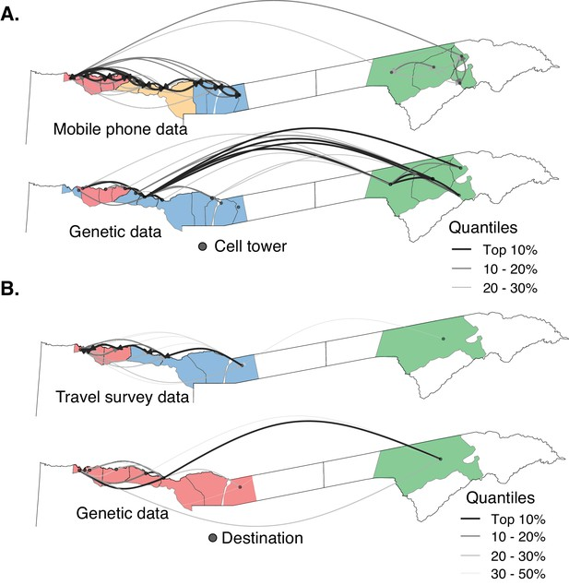
Networks for disease/malaria control
https://link.springer.com/article/10.1186/1475-2875-11-205
https://elifesciences.org/articles/43510

Slide 14
Analyzing networks
Centrality: How “central” is a node to a network?
How central is a town to the overall mobility and transmission network?

Slide 15
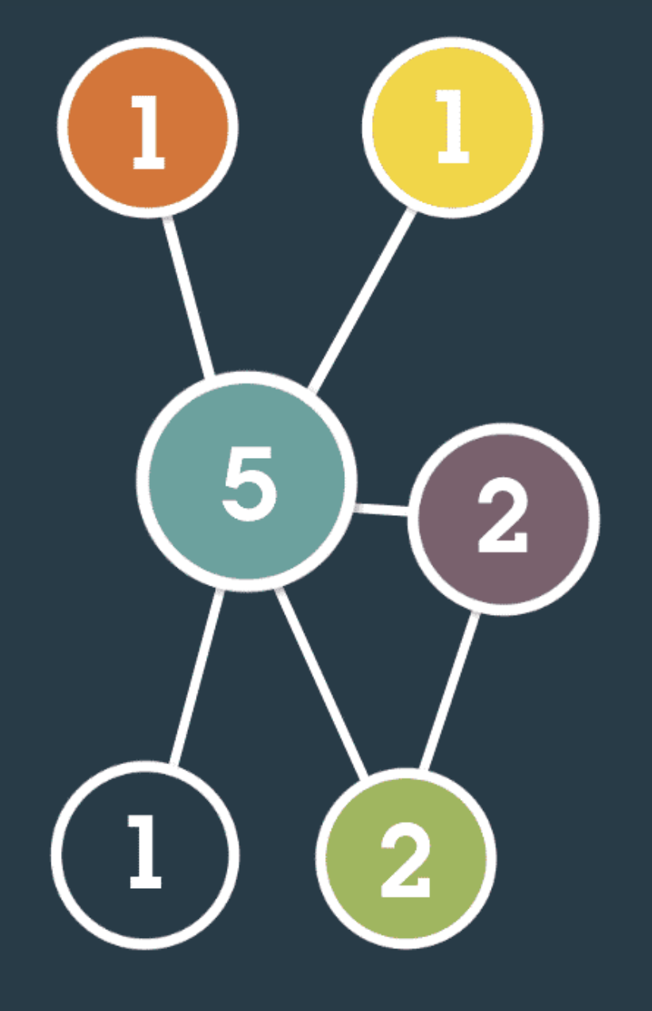
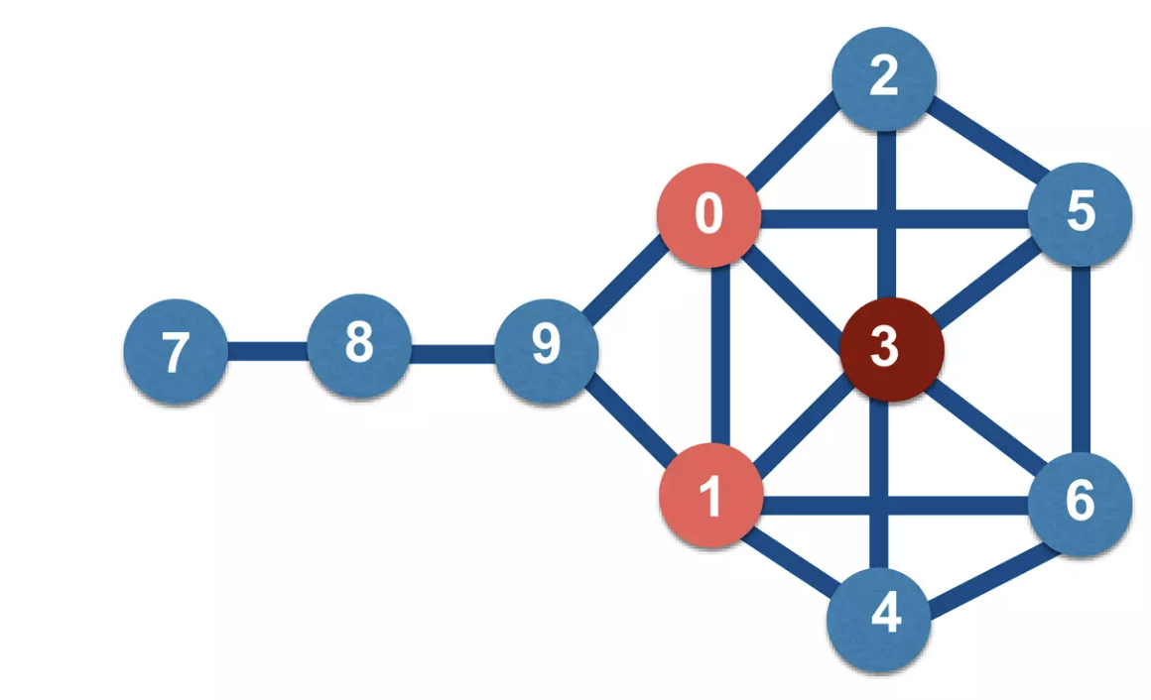
Analyzing networks
Degree centrality
Most straightforward; how strong of a connection does a place have with others?
How many people travel to this place per day?

Slide 16
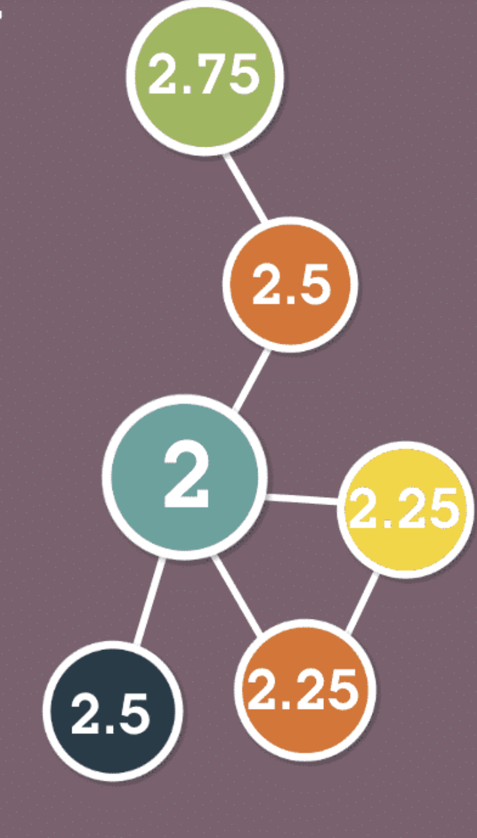
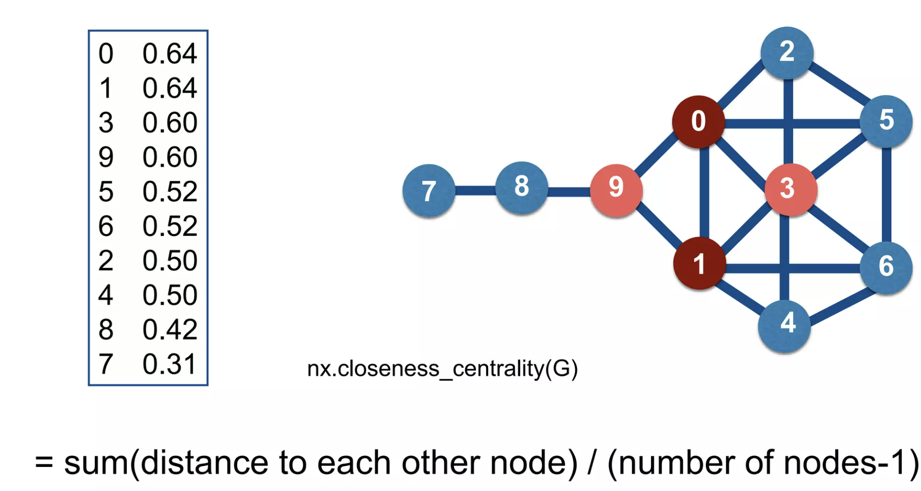
Analyzing networks
Closeness centrality
How hard is it to get to other nodes in the network?
In a disease context: How quickly would a disease spread from here to large parts of the country?

Slide 17
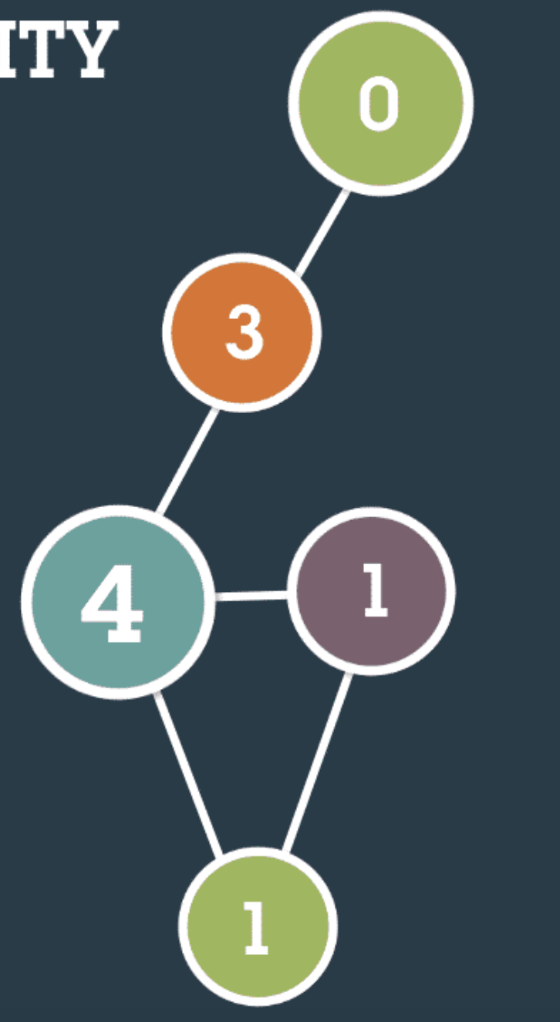
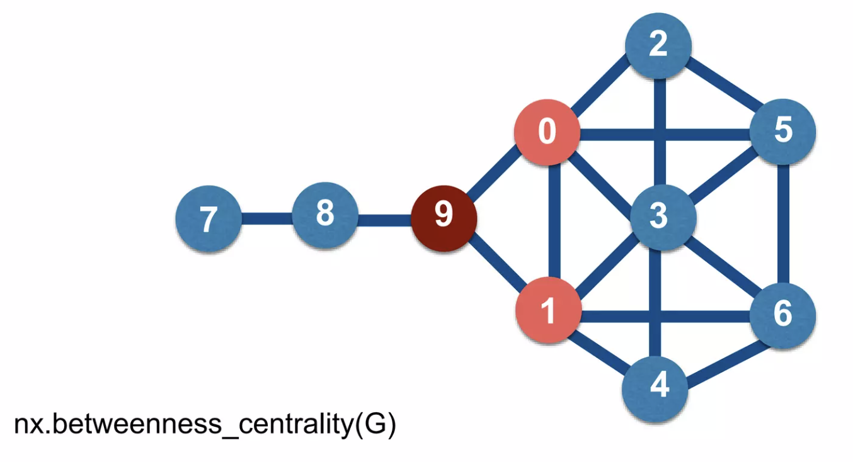
Analyzing networks
Betweenness centrality
How often do you pass through a node when going from point 1 to point 2?
Denotes places where disease may be very likely to pass through

Slide 18
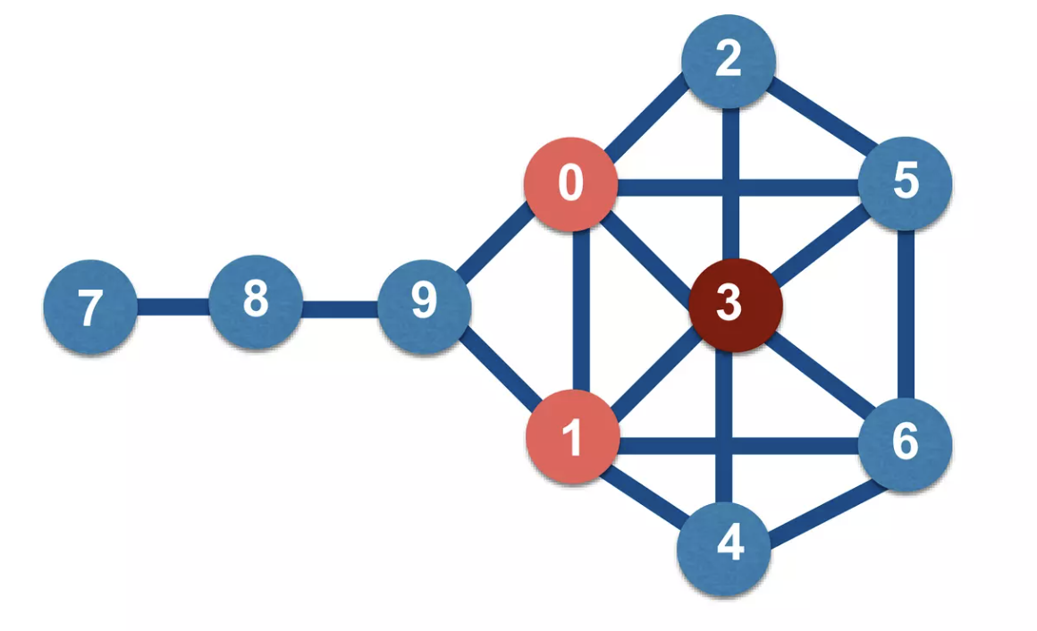
Analyzing networks
Eigenvector centrality
Measure of contribution of each node to travel across the network

Slide 19
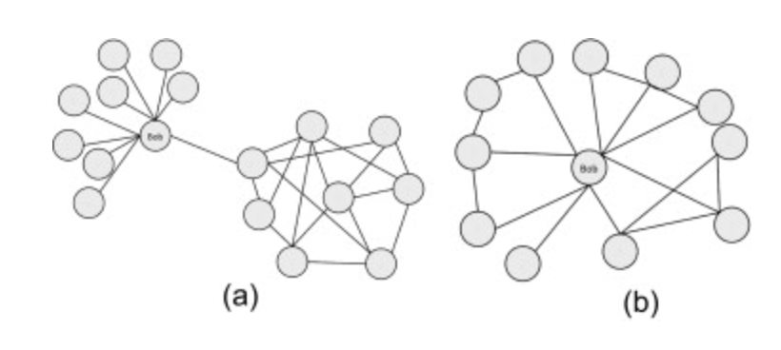
Analyzing networks
A
A
Most of the time, you will use more than one metric to summarize the importance of a location
What is the degree centrality of A on the left? The right?

Slide 20
Network-level analysis
What if we wanted to get a view of the overall connectivity and partitioning?
Which areas are most connected?
If one location has a malaria outbreak, where is it most likely to go from there?

Slide 21
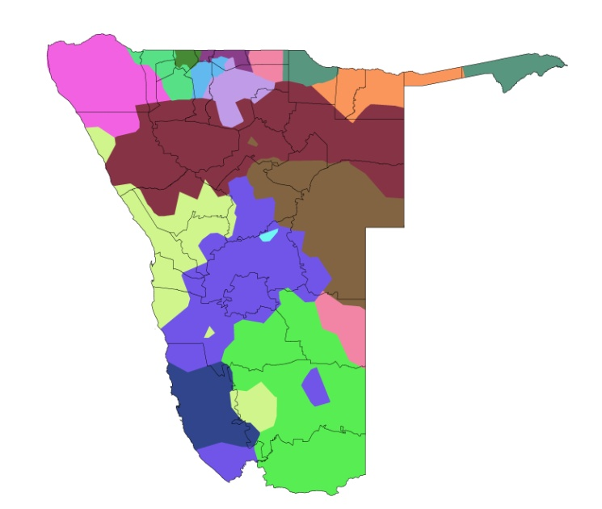
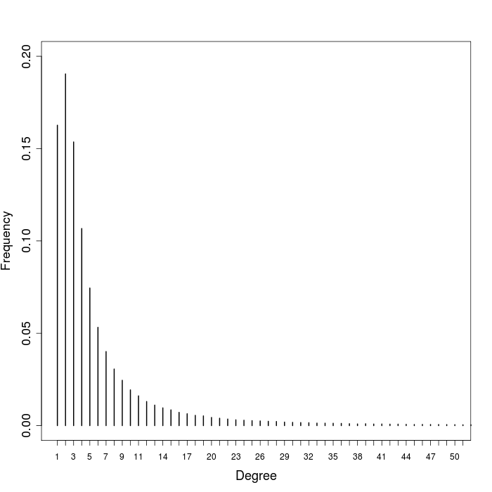
Network-level analysis
Community detection
For policy: Create maps that draw “communities” – relatively isolated groups
Clustering coefficients: How “clustered” are the communities?
Degree distribution: How is the connectivity distributed?

Slide 22
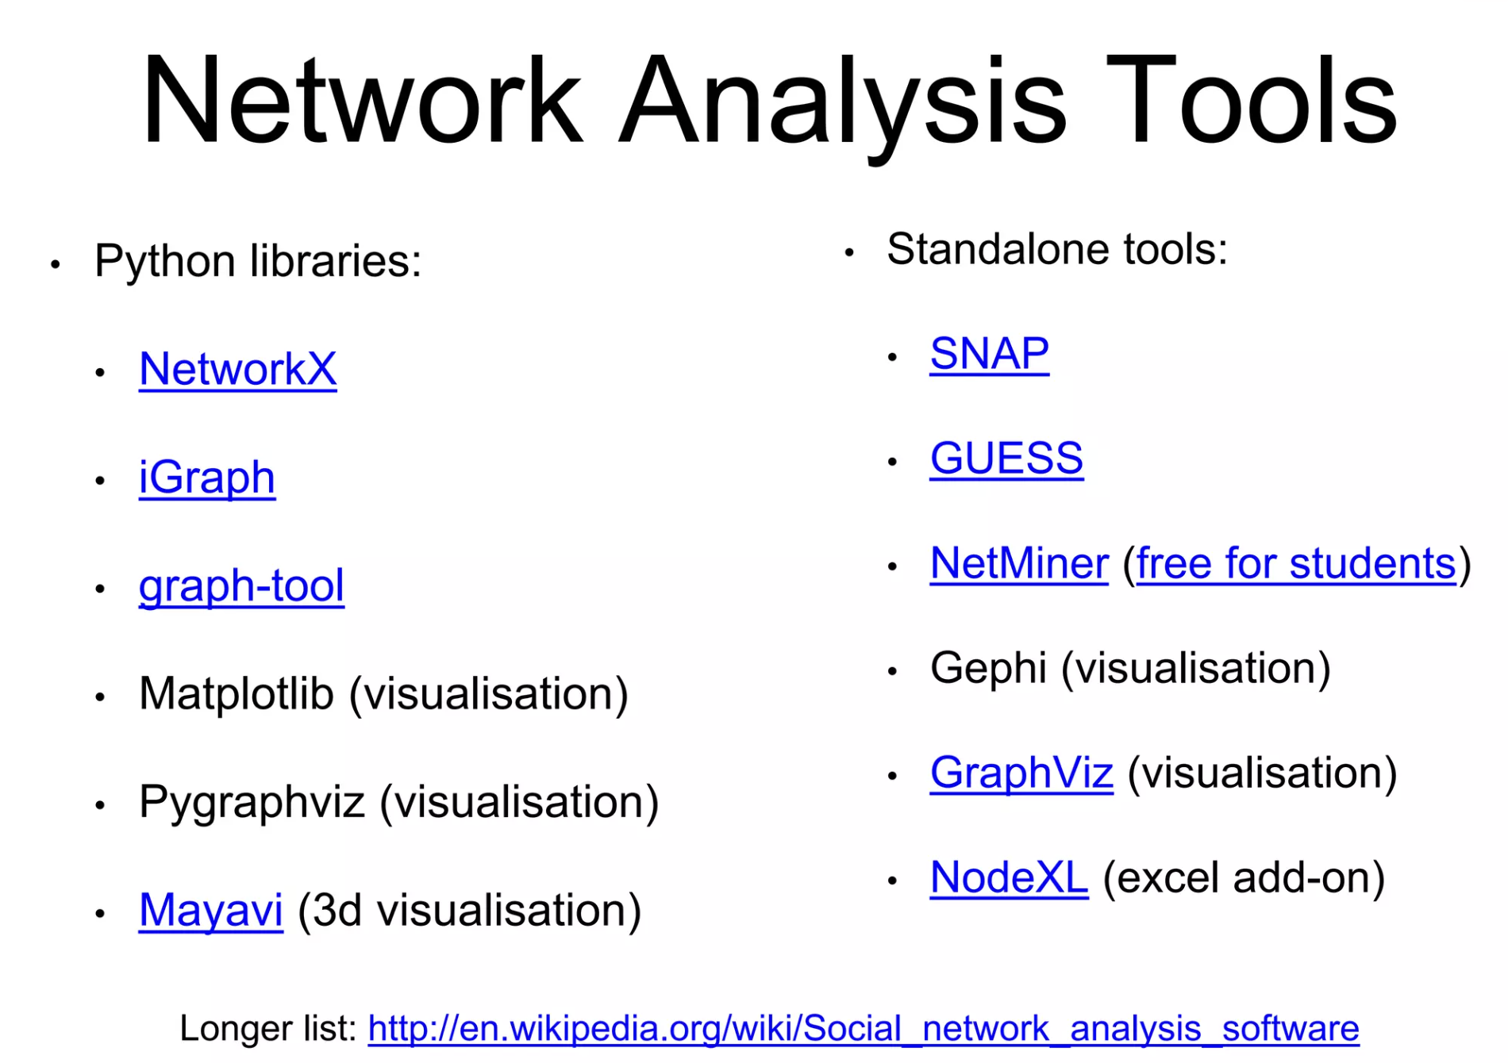

Slide 23
How?
2
1
3
A network with n nodes can be represented as n x n adjacency matrix
Could represent people, communities, or something else
Connection could be communication, or sharing a space (visiting the same house)
4
6
5
 | 1 | 2 | 3 | 4 | 5 | 6
1
2
3
4
5
6

Slide 24
How?
2
1
3
A network with n nodes can be represented as n x n adjacency matrix
Could represent people, communities, or something else
Connection could be communication, or sharing a space (visiting the same house)
4
6
5
 | 1 | 2 | 3 | 4 | 5 | 6
1 | 0
2 |  | 0
3 |  |  | 0
4 |  |  |  | 0
5 |  |  |  |  | 0
6 |  |  |  |  |  | 0

Slide 25
How?
2
1
3
A network with n nodes can be represented as n x n adjacency matrix
Could represent people, communities, or something else
Connection could be communication, or sharing a space (visiting the same house)
4
6
5
 | 1 | 2 | 3 | 4 | 5 | 6
1 | 0 | 1
2 | 1 | 0
3 |  |  | 0
4 |  |  |  | 0
5 |  |  |  |  | 0
6 |  |  |  |  |  | 0

Slide 26
How?
2
1
3
A network with n nodes can be represented as n x n adjacency matrix
Could represent people, communities, or something else
Connection could be communication, or sharing a space (visiting the same house)
4
6
5
 | 1 | 2 | 3 | 4 | 5 | 6
1 | 0 | 1
2 | 1 | 0
3 |  |  | 0
4 |  |  |  | 0
5 |  |  |  |  | 0
6 |  |  |  |  |  | 0

Slide 27
How?
2
1
3
A network with n nodes can be represented as n x n adjacency matrix
Could represent people, communities, or something else
Connection could be communication, or sharing a space (visiting the same house)
4
6
5
 | 1 | 2 | 3 | 4 | 5 | 6
1 | 0 | 1
2 | 1 | 0
3 |  |  | 0 | 0
4 |  |  | 0 | 0
5 |  |  |  |  | 0
6 |  |  |  |  |  | 0

Slide 28
How?
2
1
3
A network with n nodes can be represented as n x n adjacency matrix
Could represent people, communities, or something else
Connection could be communication, or sharing a space (visiting the same house)
4
6
5
 | 1 | 2 | 3 | 4 | 5 | 6
1 | 0 | 1 | 1 | 1 | 0 | 0
2 | 1 | 0 | 1 | 0 | 0 | 0
3 | 1 | 1 | 0 | 0 | 0 | 0
4 | 1 | 0 | 0 | 0 | 1 | 1
5 | 0 | 0 | 0 | 1 | 0 | 1
6 | 0 | 0 | 0 | 1 | 1 | 0

Slide 29

How?
 | 1 | 2 | 3 | 4 | 5 | 6
1 | 0 | 1 | 1 | 1 | 0 | 0
2 | 1 | 0 | 1 | 0 | 0 | 0
3 | 1 | 1 | 0 | 0 | 0 | 0
4 | 1 | 0 | 0 | 0 | 1 | 1
5 | 0 | 0 | 0 | 1 | 0 | 1
6 | 0 | 0 | 0 | 1 | 1 | 0
“walktrap” algorithm
Start with n communities: each node a community
Place random walkers on network
Moving depends on adjacency matrix
2
1
3
4
6
5

Slide 30
How?
 | 1 | 2 | 3 | 4 | 5 | 6
1 | 0 | 1 | 1 | 1 | 0 | 0
2 | 1 | 0 | 1 | 0 | 0 | 0
3 | 1 | 1 | 0 | 0 | 0 | 0
4 | 1 | 0 | 0 | 0 | 1 | 1
5 | 0 | 0 | 0 | 1 | 0 | 1
6 | 0 | 0 | 0 | 1 | 1 | 0
“walktrap” algorithm
Start with n communities: each node a community
Place random walkers on network
Moving depends on adjacency matrix
Watch ‘em go
Record steps from one node to another
2
1
3
4
6
5

Slide 31
How?
 | 1 | 2 | 3 | 4 | 5 | 6
1 | 0 | 1 | 1 | 1 | 0 | 0
2 | 1 | 0 | 1 | 0 | 0 | 0
3 | 1 | 1 | 0 | 0 | 0 | 0
4 | 1 | 0 | 0 | 0 | 1 | 1
5 | 0 | 0 | 0 | 1 | 0 | 1
6 | 0 | 0 | 0 | 1 | 1 | 0
“walktrap” algorithm
Start with n communities: each node a community
Place random walkers on network
Moving depends on adjacency matrix
Watch ‘em go
Record steps from one node to another
2
1
3
4
[1,3]: 1 step
6
5

Slide 32
How?
 | 1 | 2 | 3 | 4 | 5 | 6
1 | 0 | 1 | 1 | 1 | 0 | 0
2 | 1 | 0 | 1 | 0 | 0 | 0
3 | 1 | 1 | 0 | 0 | 0 | 0
4 | 1 | 0 | 0 | 0 | 1 | 1
5 | 0 | 0 | 0 | 1 | 0 | 1
6 | 0 | 0 | 0 | 1 | 1 | 0
“walktrap” algorithm
Start with n communities: each node a community
Place random walkers on network
Moving depends on adjacency matrix
Watch ‘em go
Record steps from one node to another
2
1
3
4
[1,3]: 1 step
6
5

Slide 33
How?
 | 1 | 2 | 3 | 4 | 5 | 6
1 | 0 | 1 | 1 | 1 | 0 | 0
2 | 1 | 0 | 1 | 0 | 0 | 0
3 | 1 | 1 | 0 | 0 | 0 | 0
4 | 1 | 0 | 0 | 0 | 1 | 1
5 | 0 | 0 | 0 | 1 | 0 | 1
6 | 0 | 0 | 0 | 1 | 1 | 0
“walktrap” algorithm
Start with n communities: each node a community
Place random walkers on network
Moving depends on adjacency matrix
Watch ‘em go
Record steps from one node to another
2
1
3
4
[1,3]: 1 step
6
5

Slide 34
How?
 | 1 | 2 | 3 | 4 | 5 | 6
1 | 0 | 1 | 1 | 1 | 0 | 0
2 | 1 | 0 | 1 | 0 | 0 | 0
3 | 1 | 1 | 0 | 0 | 0 | 0
4 | 1 | 0 | 0 | 0 | 1 | 1
5 | 0 | 0 | 0 | 1 | 0 | 1
6 | 0 | 0 | 0 | 1 | 1 | 0
“walktrap” algorithm
Start with n communities: each node a community
Place random walkers on network
Moving depends on adjacency matrix
Watch ‘em go
Record steps from one node to another
2
1
3
4
[1,3]: 1 step
[1,3]: 2 steps
6
5

Slide 35
How?
 | 1 | 2 | 3 | 4 | 5 | 6
1 | 0 | 1 | 1 | 1 | 0 | 0
2 | 1 | 0 | 1 | 0 | 0 | 0
3 | 1 | 1 | 0 | 0 | 0 | 0
4 | 1 | 0 | 0 | 0 | 1 | 1
5 | 0 | 0 | 0 | 1 | 0 | 1
6 | 0 | 0 | 0 | 1 | 1 | 0
“walktrap” algorithm
Start with n communities: each node a community
Place random walkers on network
Moving depends on adjacency matrix
Watch ‘em go
Calculate distance: # steps between nodes
2
1
3
4
[1,3]: 1 step
[1,3]: 2 steps
6
5

Slide 36
How?
 | 1 | 2 | 3 | 4 | 5 | 6
1 | 0 | 1 | 1 | 1 | 0 | 0
2 | 1 | 0 | 1 | 0 | 0 | 0
3 | 1 | 1 | 0 | 0 | 0 | 0
4 | 1 | 0 | 0 | 0 | 1 | 1
5 | 0 | 0 | 0 | 1 | 0 | 1
6 | 0 | 0 | 0 | 1 | 1 | 0
“walktrap” algorithm
Start with n communities: each node a community
Place random walkers on network
Moving depends on adjacency matrix
Watch ‘em go
Calculate distance: # steps between nodes
The two closest nodes are then put into a community
Start over and keep aggregating communities
2
1
3
4
[1,3]: 1 step
[1,3]: 2 steps
6
5

Slide 37
How?
 | 1 | 2 | 3 | 4 | 5 | 6
1 | 0 | 1 | 1 | 1 | 0 | 0
2 | 1 | 0 | 1 | 0 | 0 | 0
3 | 1 | 1 | 0 | 0 | 0 | 0
4 | 1 | 0 | 0 | 0 | 1 | 1
5 | 0 | 0 | 0 | 1 | 0 | 1
6 | 0 | 0 | 0 | 1 | 1 | 0
“walktrap” algorithm
Start with n communities: each node a community
Place random walkers on network
Moving depends on adjacency matrix
Watch ‘em go
Calculate distance: # steps between nodes
The two closest nodes are then put into a community
Start over and keep aggregating communities
2
1
3
4
6
5

Slide 38
How?
 | 1 | 2 | 3 | 4 | 5 | 6
1 | 0 | 1 | 1 | 1 | 0 | 0
2 | 1 | 0 | 1 | 0 | 0 | 0
3 | 1 | 1 | 0 | 0 | 0 | 0
4 | 1 | 0 | 0 | 0 | 1 | 1
5 | 0 | 0 | 0 | 1 | 0 | 1
6 | 0 | 0 | 0 | 1 | 1 | 0
“walktrap” algorithm
Start with n communities: each node a community
Place random walkers on network
Moving depends on adjacency matrix
Watch ‘em go
Calculate distance: # steps between nodes
The two closest nodes are then put into a community
Start over and keep aggregating communities
2
1
3
4
6
5

Slide 39
How?
2
Community structure is hierarchical
1
3
4
6
5

Slide 40
How?
2
Community structure is hierarchical
1
3
4
6
5

Slide 41
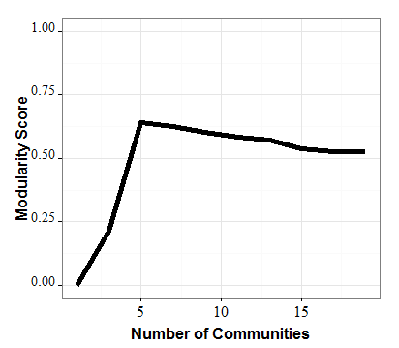
How?
2
1
3
Community structure is hierarchical
When to stop?
Modularity score (Q)
% of connections within communities - % expected if random
High Q means more connections within vs. between community
Max -> Optimal community structure
4
6
5

Slide 42
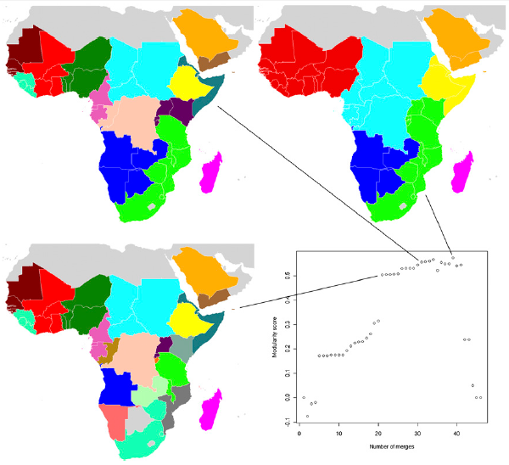
Planning regional elimination
Organization of elimination
Community detection
Draw divisions to maximize difference within-community and between
Tatem et al 2007; but national focus, old migration data

Slide 43
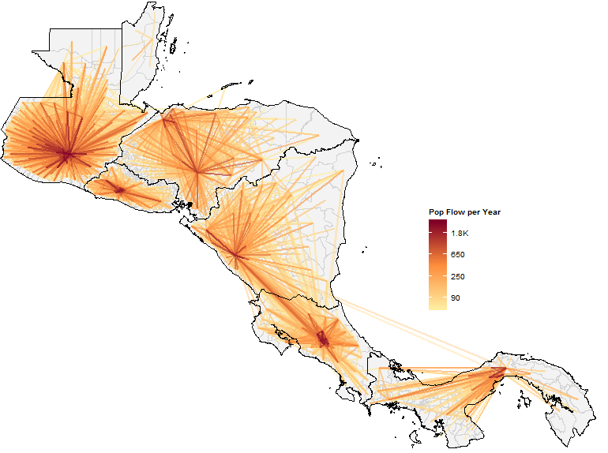

Slide 44
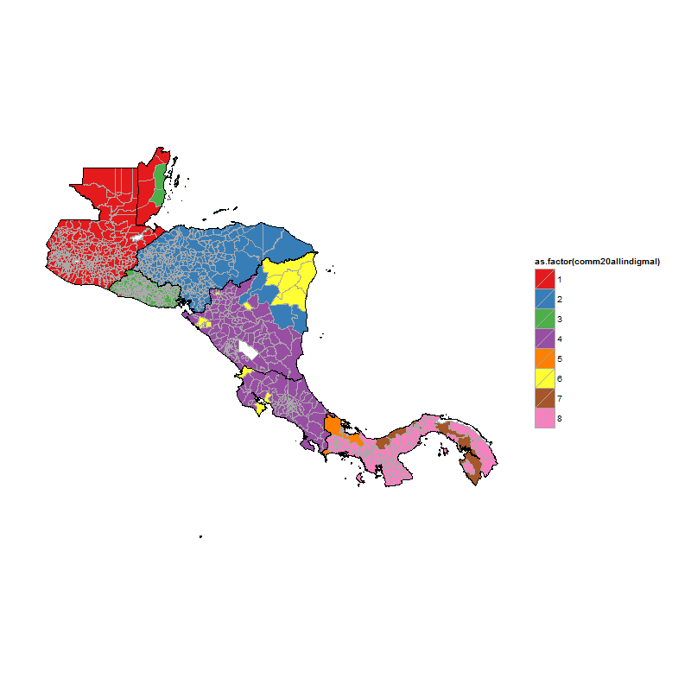
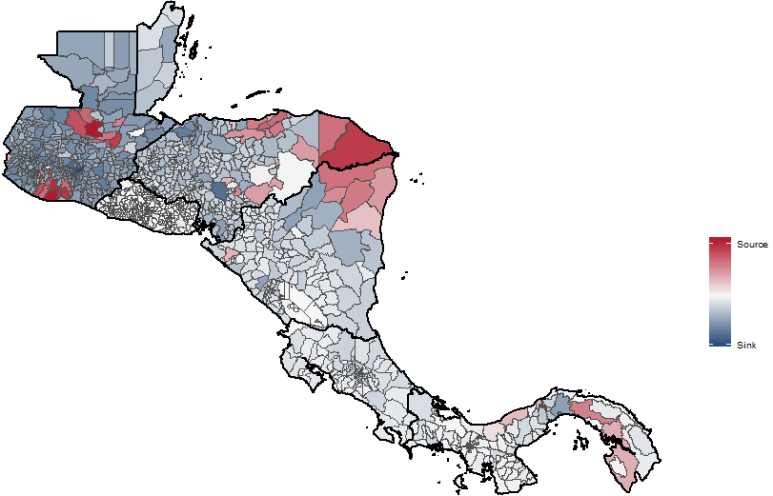
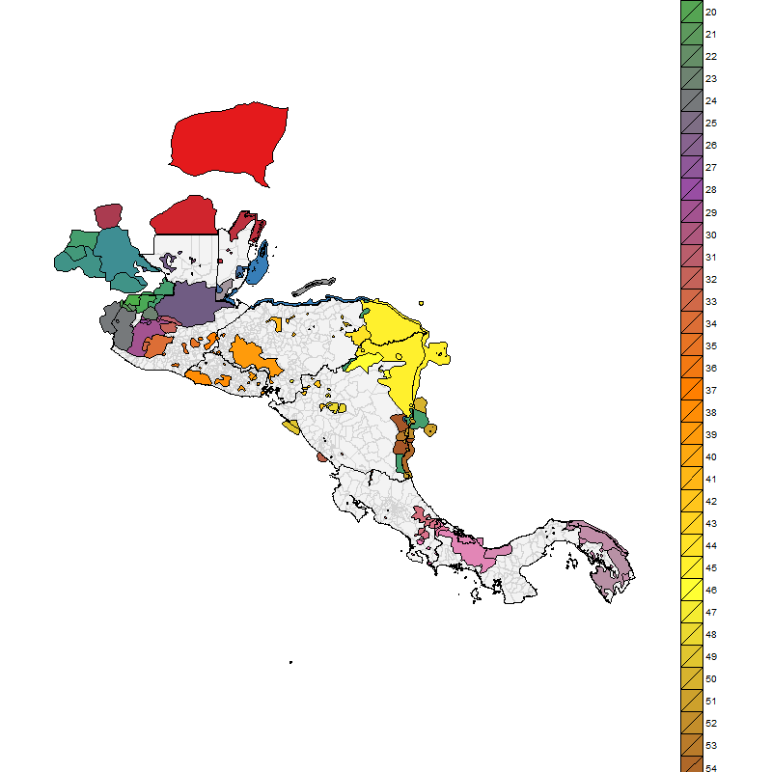
Can add local knowledge, ancillary data
Ruktanonchai et al. (2016) Mal J

Slide 45
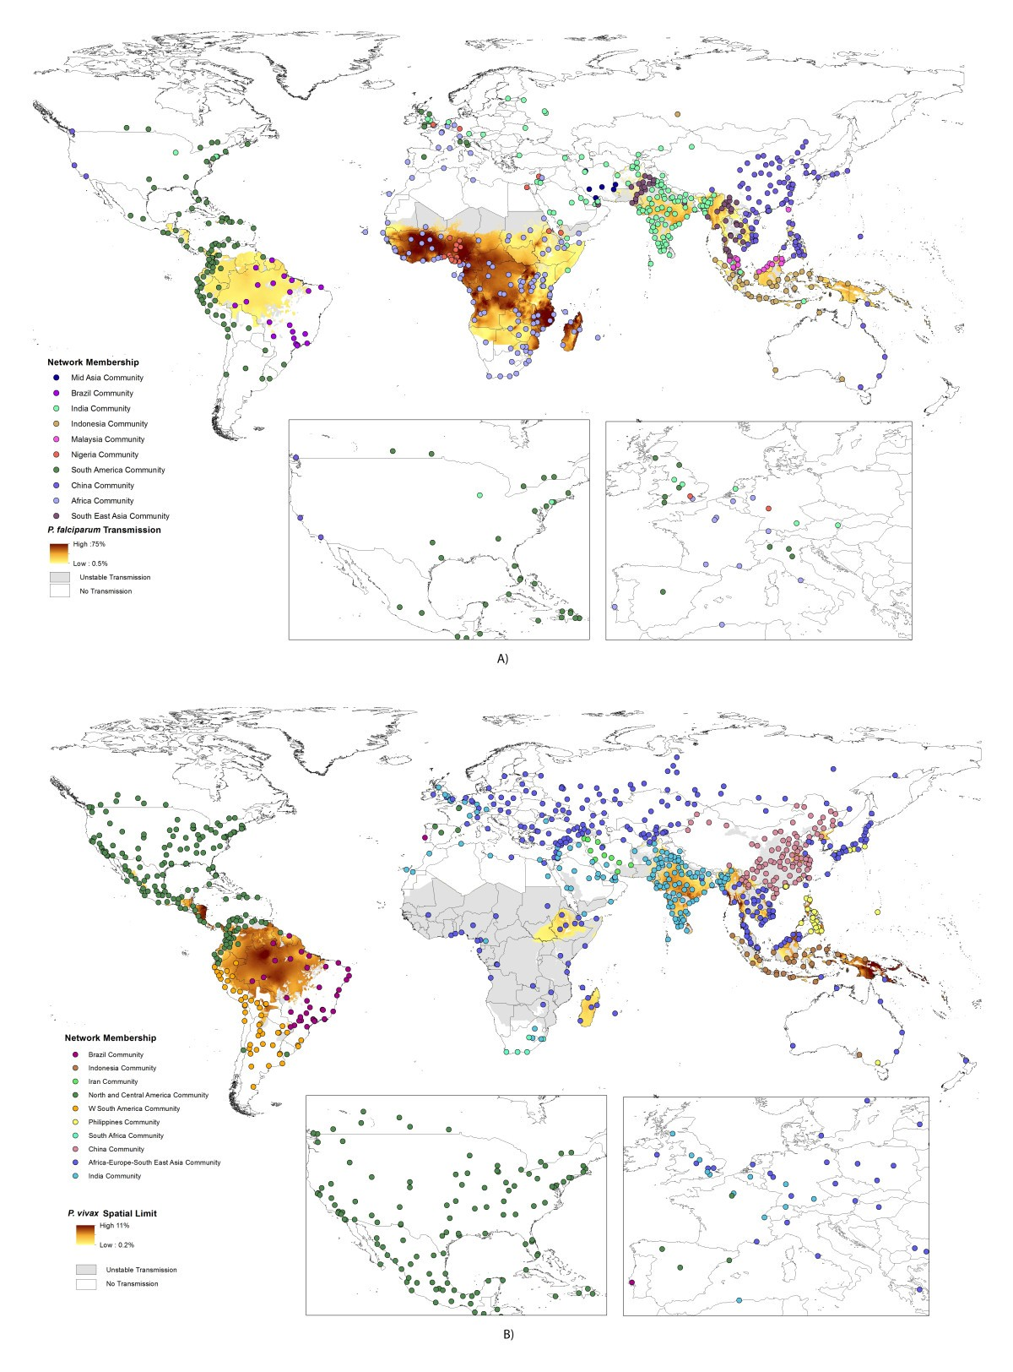
https://link.springer.com/article/10.1186/1475-2875-12-269/figures/1

Slide 47
Epidemiology, space, and mobility
Infectious disease still very important in poorer countries
Reducing burden essential for a more equal world
Human mobility is inextricable from disease transmission, regardless of type of disease
We can use mobility to better understand disease through analyses like social network analysis:
How countries and regions are connected
Characteristics of superspreaders

Slide 48
Worksheet
Practice with network analysis & plotting results

